Slide 1
Bluetooth
Bluetooth is a wireless LAN technology designed to connect devices of different functions when they are at a short distance from each other
A Bluetooth LAN is an ad hoc network
The devices, sometimes called gadgets, find each other and make a network called a Piconet

Slide 2
Bluetooth
Bluetooth technology is the implementation of a protocol defined by the IEEE 802.15 standard
The standard defines a wireless Personal-Area Network (PAN) operable in an area the size of a room or a hall

Slide 3
Architecture
Bluetooth defines two types of networks:
Piconet
Scatternet

Slide 4
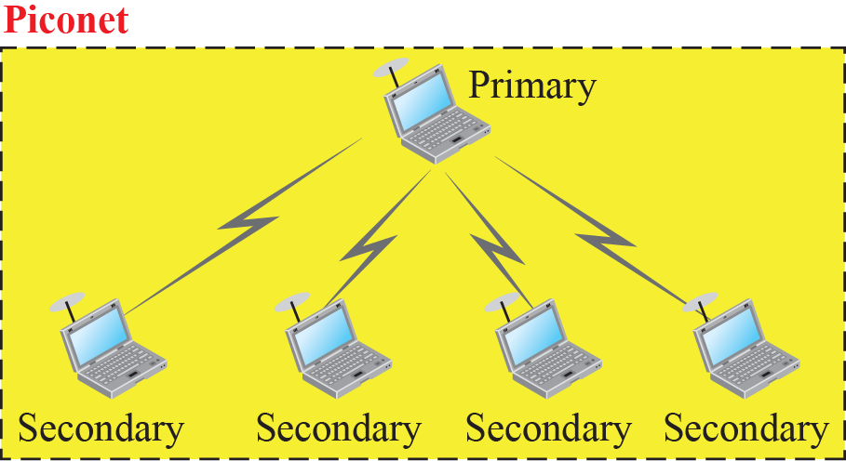
Piconet

Slide 5
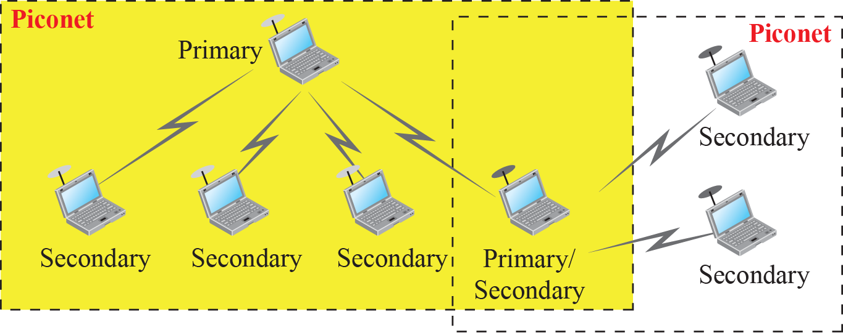
Scatternet

Slide 6
Bluetooth Devices
A Bluetooth device has a built-in short-range radio transmitter
The current data rate is 1 Mbps with a 2.4-GHz bandwidth
This means that there is a possibility of interference between the IEEE 802.11b wireless LANs and Bluetooth LANs

Slide 7
Bluetooth Layers
Bluetooth uses several layers that do not exactly match those of the Internet model we have defined already

Slide 8
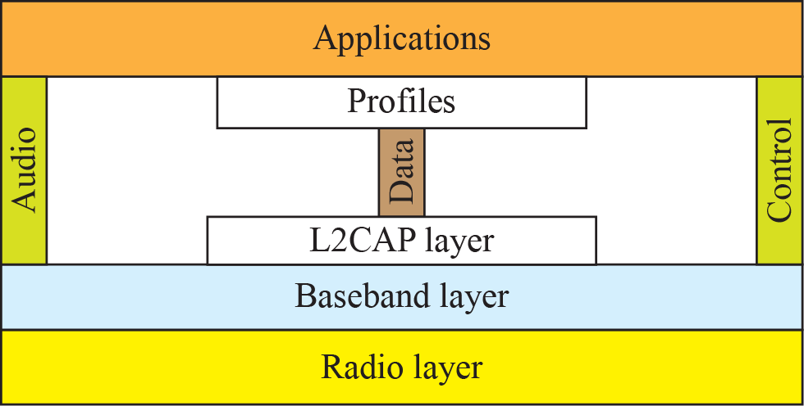
Bluetooth Layers

Slide 9
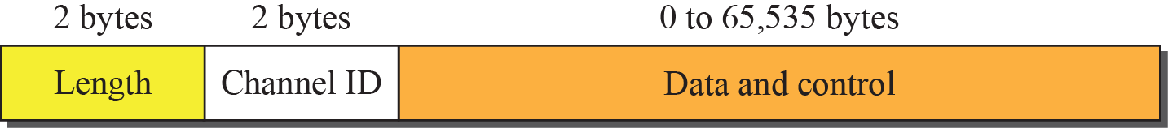
L2CAP Data Packet Format

Slide 10
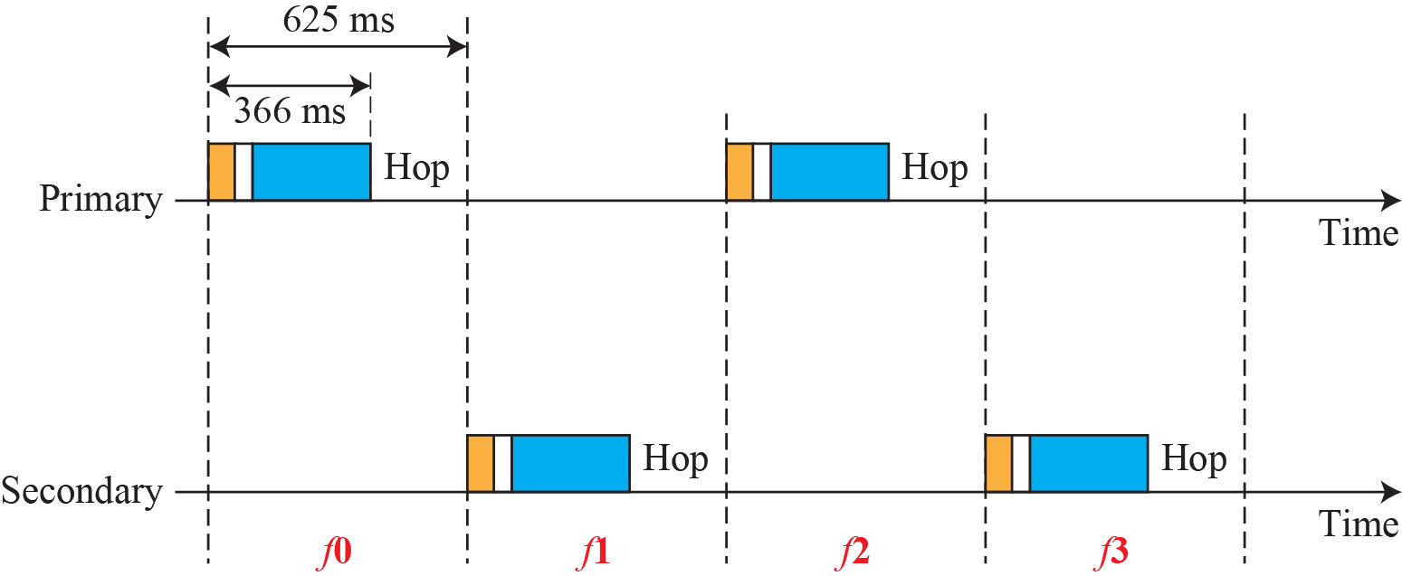
Single-Secondary Communication

Slide 11
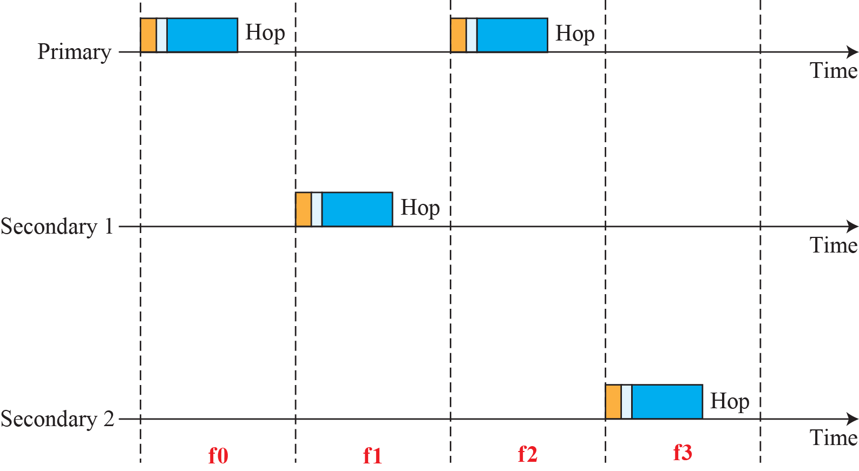
Multiple-Secondary Communication

